Slide 1
Animal Phyla

Slide 2

We classify different animals based on what they have in common (similarities) and how they differ (differences).
Human beings always felt the need to classify, you do it everyday without realising it!

Slide 3

With a total of 1.3 million species identified and described to date, it's easy to understand why classification is important!
Also, scientists know that there are more species out there. The most accurate census estimates a total of 8.7million species living around the planet.

Slide 4
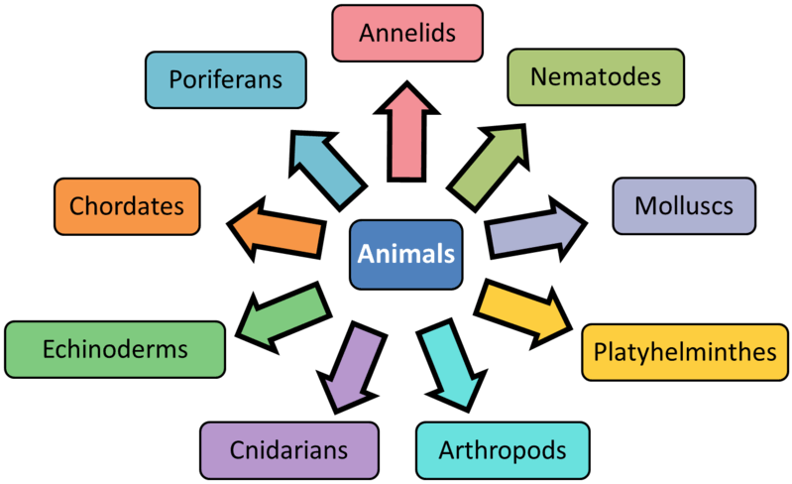
Remember the taxonomic level below Kingdom?
There are 9 main phyla within Kingdom Animalia. Animals are classified into these phyla based on their observable features.
In this lesson, you will learn about the 9 main phyla, and what makes each one special!

Slide 5
Phylogenetics is the science that focus on species relationships by looking at their evolution.
A way to represent these relationships between phyla is by drawing a cladogram.

Slide 6
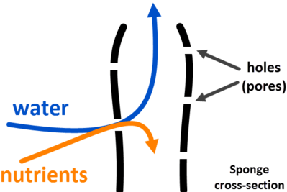
Poriferans (means "pore bearers)
Poriferans are found in most marine environments, especially reefs. They are commonly known as sponges.
They get this name due to the holes (pores) in their structure, which allow the flow of water and nutrients (food). They filter out the nutrients in the water, then waste products are passed back out an opening at the top of the sponge.

Slide 7
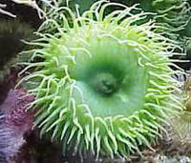
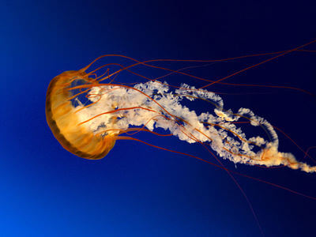
Cnidarians (means "stinging nettle," pronounced knee-dar-ee-ans)
Cnidarians are animals like jellyfish and sea anemones, which have soft, hollow bodies. Cnidarians have one body opening where both food and waste enters and exits.
Cnidarians catch food with stinging tentacles. The tentacles of the box jellyfish contain a venom that is toxic enough to kill humans. Sometimes they wash up on Australian beaches - take care around strange jellies!

Slide 8
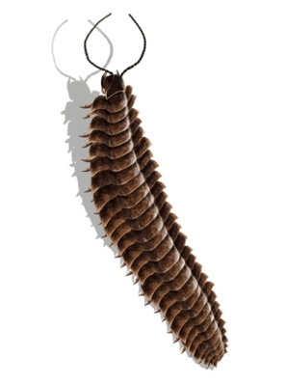
Arthropod (means "jointed foot," pronounced arr-throw-pods)
The arthropod phylum contains 80% of all animal species! Arthropods can be found in water, on land and in the air. They include the things we call "creepy-crawlies" - spiders, flies, crabs, beetles, millipedes and so on.

Slide 9
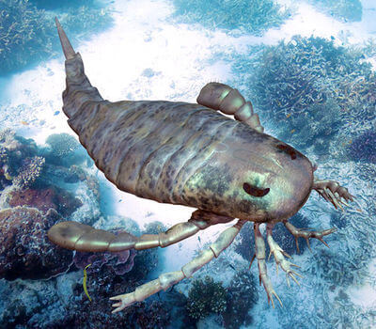
Arthropods (means "jointed foot")
Arthropods are invertebrates with an external skeleton, a shell made of hard segments. Their legs are also armoured and have special joints so they can move. Their shells protect them from other animals and hold all their organs in place.

Slide 10
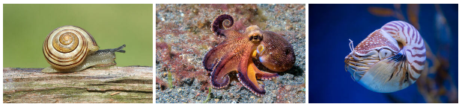
Mollusca
Molluscs make up the second largest phylum of the animal kingdom. They are found in moist places or in water. Molluscs come in different shapes and sizes and have bilateral symmetry and a muscular foot which aids movement.
The phylum mollusca includes gastropods and cephalopods. Snails are examples of gastropods, while octopuses, squid and ammonites are examples of cephalopods.

Slide 11
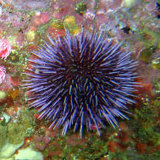
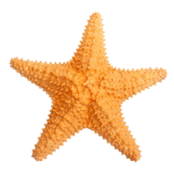
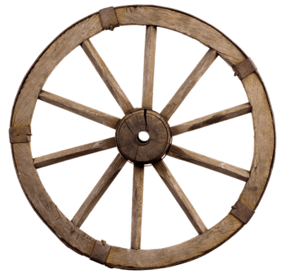
Echinoderms (means "spiny skin," pronounced eek-ine-o-derms)
Echinoderms are animals like starfish and sea urchins, which live in the ocean. The name 'echinoderm' means 'spiny skin' - these animals are spiky and usually have a hard shell.
All echinoderms have radial symmetry. This means their bodies are arranged in a circular way. The arms of a starfish point out from its centre, like the spokes of a wheel.

Slide 12
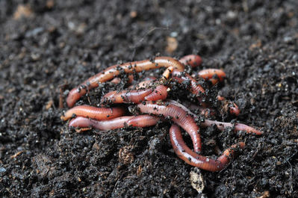
Annelids (means "ringed worms")
To us, worms might not seem like important animals, but they make up several phyla of animals. Annelids are the most familiar worms. They include earthworms, which have soft bodies arranged in segments.
They have two body openings, one where food enters and another one where waste exits. They are often found in water, as well as soil and undergrowth.

Slide 13
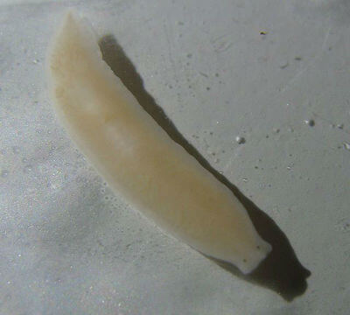
Platyhelminthes (means "flat worm," pronounced plat-ee-helm-in-thees)
Platyhelminthes are flat worms. Like annelids, they are found in water and damp places. Unlike annelids, their bodies are flat and not segmented. Many Platyhelminthes have eyes and a simple brain.

Slide 14
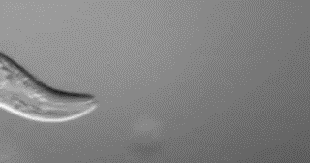
Nematodes (means "thread form")
Nematodes look very similar to annelids - they are another type of worm, called round worms.
Nematodes are found in water, damp and dark places, or in other organisms as parasites. Parasites live inside a host organism where they take nutrients (food) from it, but don't kill it.

Slide 15

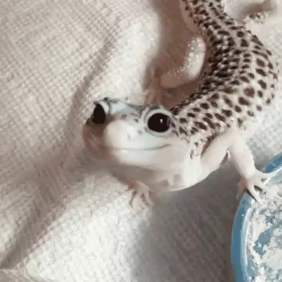
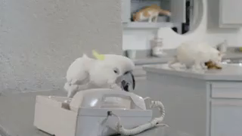
Chordates (vertebrates)
Finally, we get to the group of animals called vertebrates. They are all grouped in the phylum Chordata. This is the phylum we belong to, along with all fish, reptiles, amphibians, birds and other mammals!

Slide 16
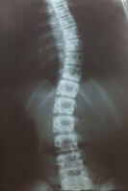
Chordates (vertebrates)
Chordates have a spinal cord, which is a long nerve running down their back. Bones that protect the spinal cord are called vertebrae and they make up the backbone. Run your fingers down your back and you can feel your own backbone!

Slide 17
